Slide 1


Malaria Diagnosis Using Convolutional Neural Networks on Thin Blood Smear Images
Shikhar Srivastava
x18106960
Submitted to: Dr. Christian Horn

Slide 2
Agenda
Malaria
Motivation
Need for Automated Malaria Diagnosis
Dataset Understanding
Research Questions
Methodology
Data Preparation
Models Used
Evaluation and Results
Conclusion & Future Work

Slide 3
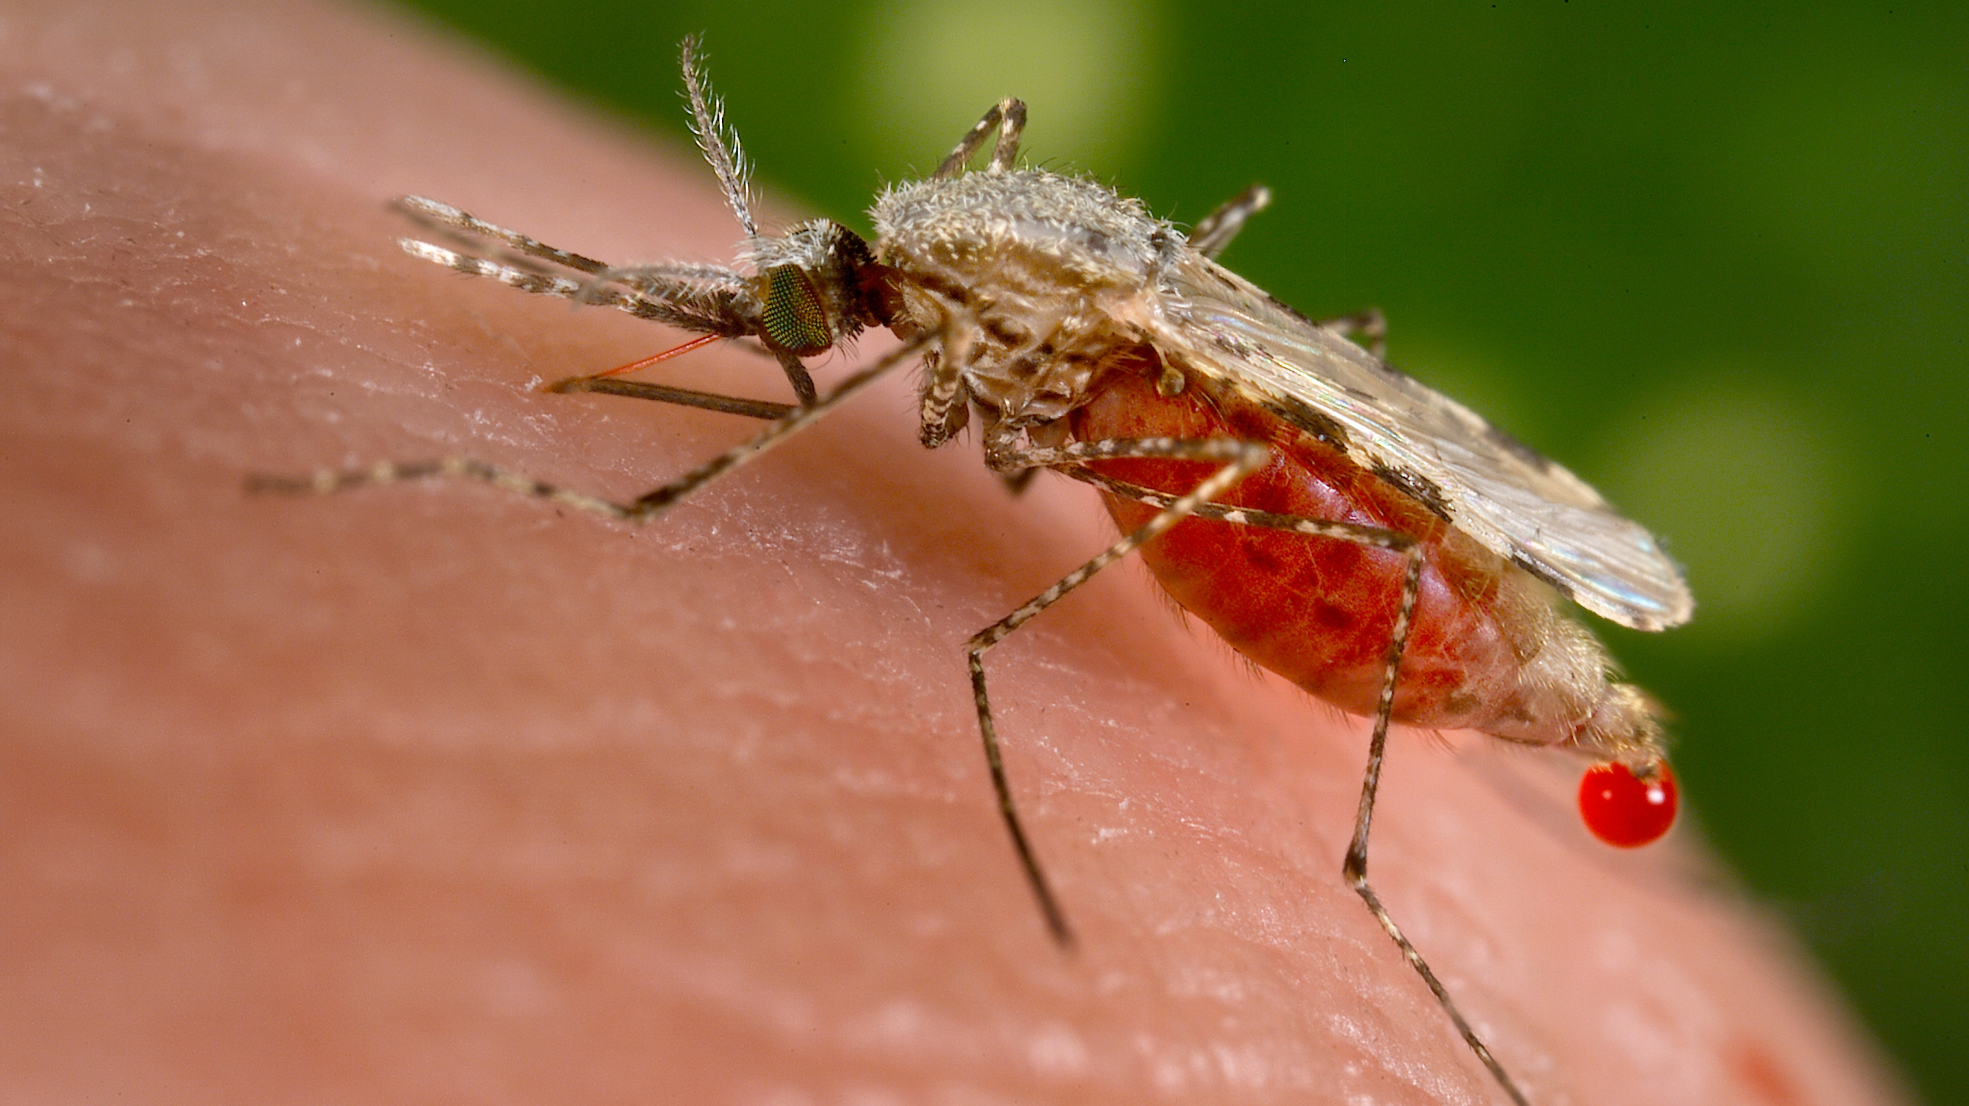


Malaria
Female Anopheles Mosquito
Plasmodium vivax
Plasmodium falciparum
Plasmodium khowlesi
Plasmodium malariae
Plasmodium ovale

Slide 4
Malaria
Female Anopheles Mosquito
Plasmodium vivax
Plasmodium falciparum
Plasmodium khowlesi
Plasmodium malariae
Plasmodium ovale

Slide 5
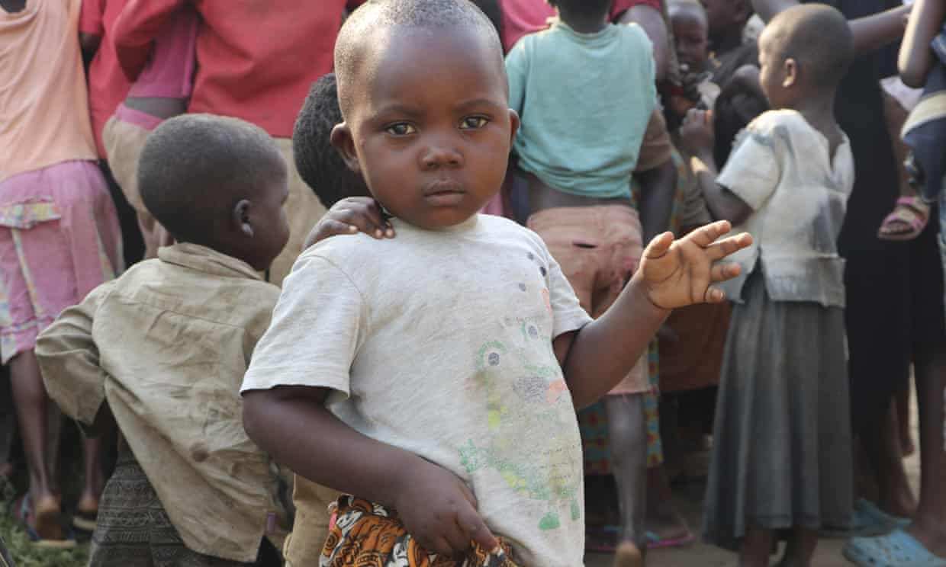

Motivation
Burundi Outbreak
Considered similar to Ebola outbreak in Democratic Republic of Congo(DRC)
1800 deaths since January
Almost 6 million cases reported since January (figures gathered by WHO)

Slide 6
Need for automated malaria diagnosis
Patient Blood Sample
Sent to Laboratory
Stained and Tested for Malaria Parasite
Most common test for Malaria – Lab test using a powerful microscope
Blood samples are sent to Lab where technicians spread it over a slide to check for parasites
No. of parasites in blood change everyday
Blood sample drawn several times over 2-3 days.
Takes some time to diagnose
2-3 days

Slide 7
Research Questions
"Can deep learning models help diagnose malaria by applying computer vision technology on thin blood smear images?"
Based on the time problem discussed, following research questions have been formulated
"Can this research achieve promising results for a small sample of images?"

Slide 8
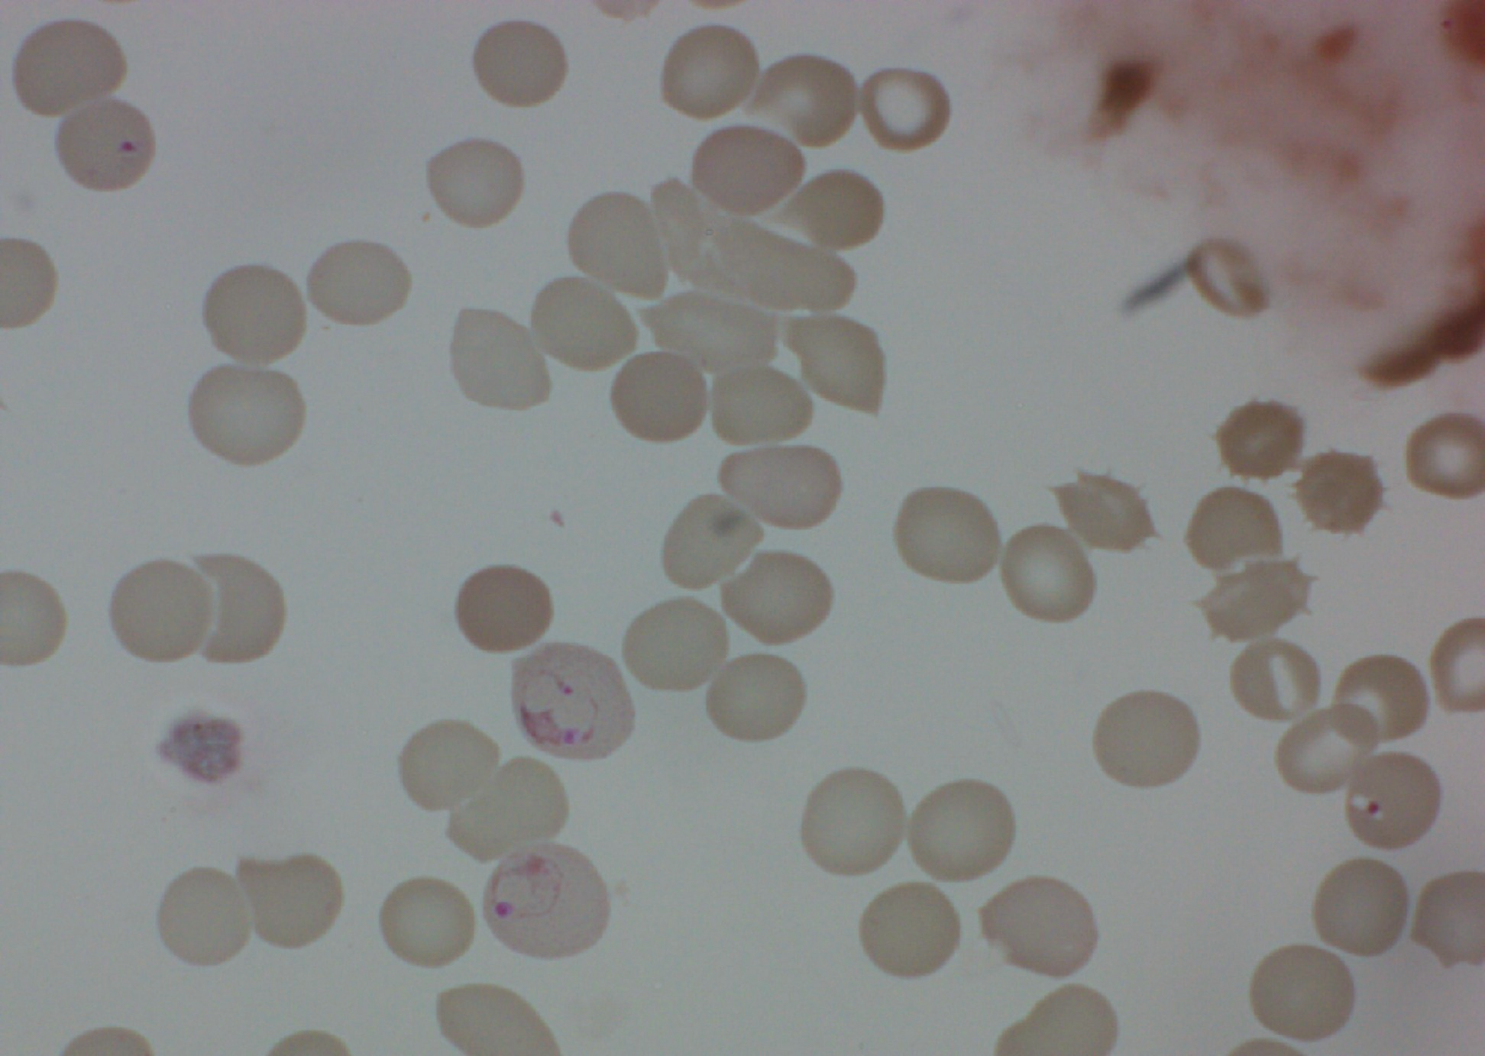
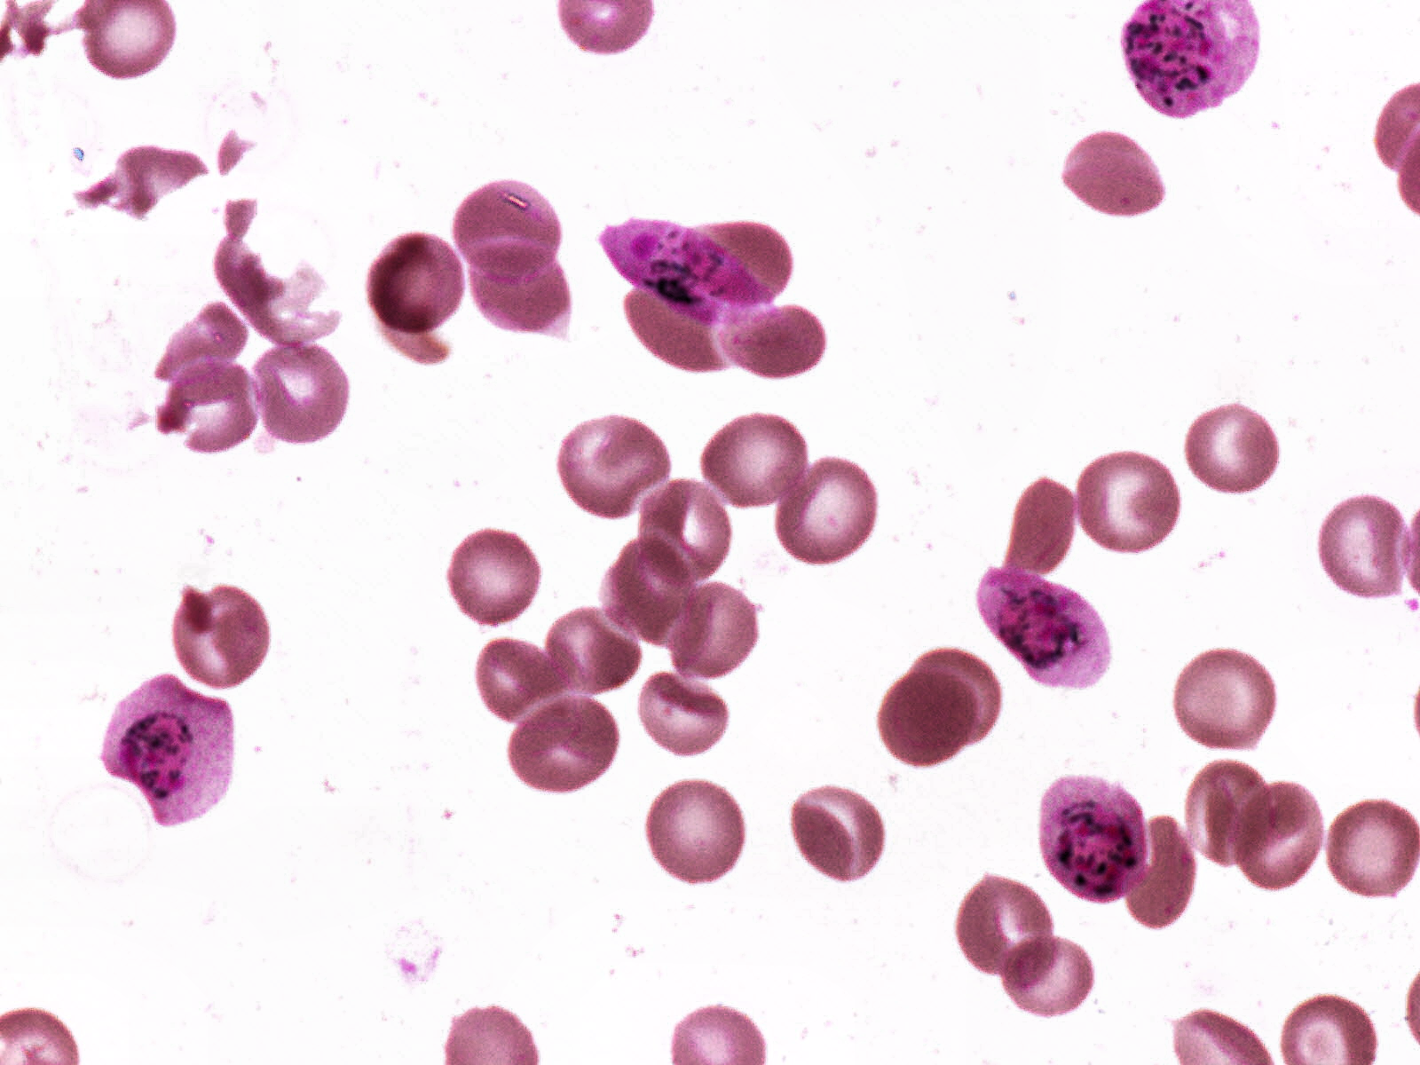
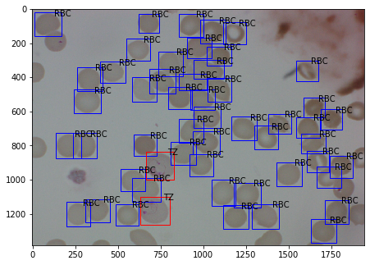
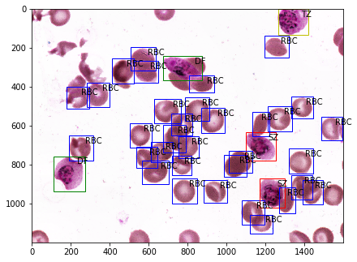
Data understanding
Data has been acquired from Broad Institute website.
Size of zipped folder downloaded is 2.26 GB
1364 images are present in the dataset
2 classes of uninfected cells (RBCs and leukocytes)
4 classes of infected cells (gametocytes, rings, trophozoites, and schizonts)
Few cells were marked “difficult”
Class imbalance

Slide 9
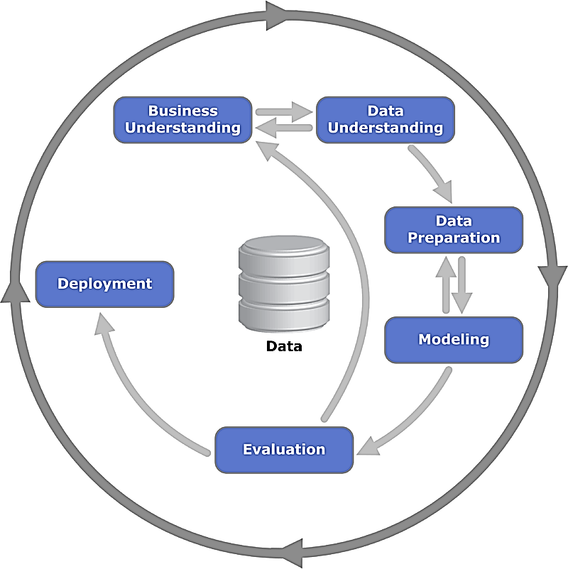
Methodology
CRISP-DM methodology is followed for this research project

Slide 10
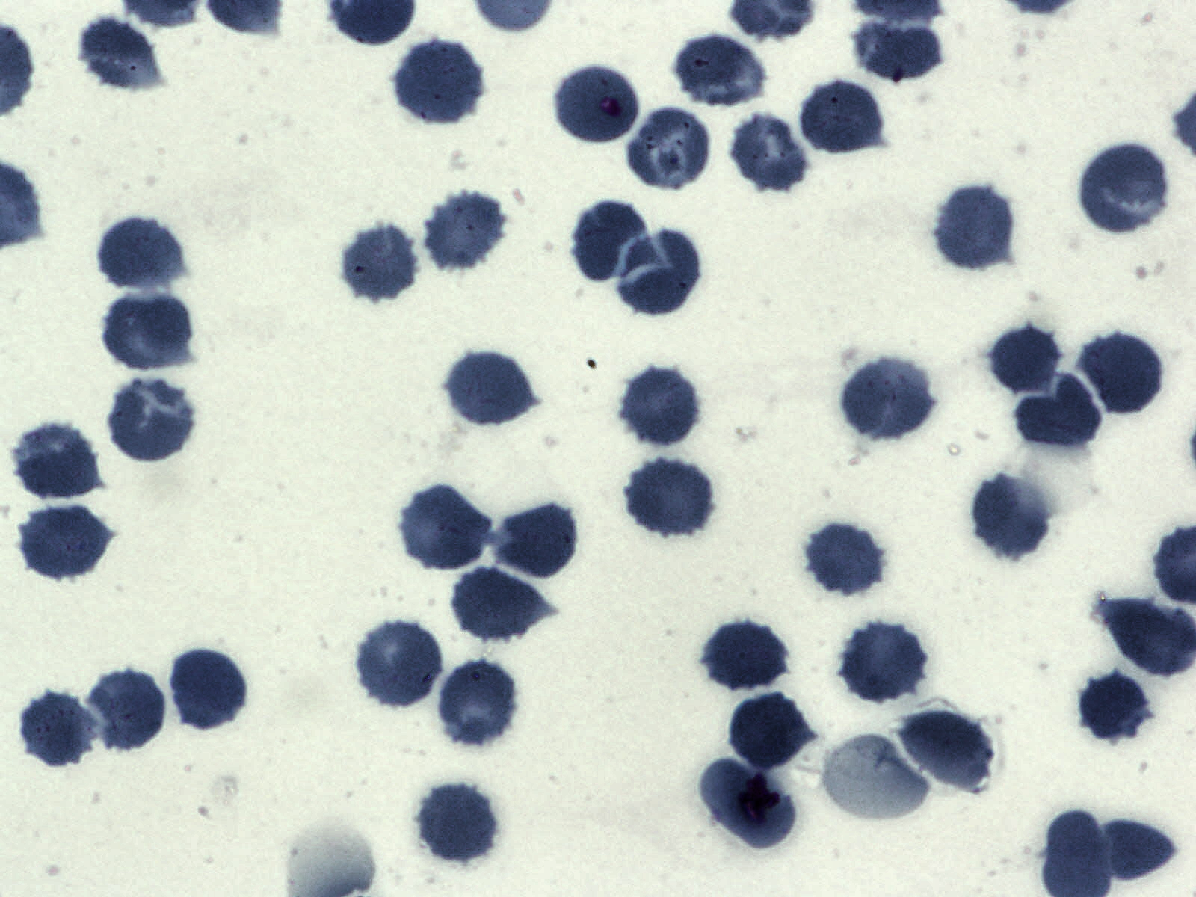
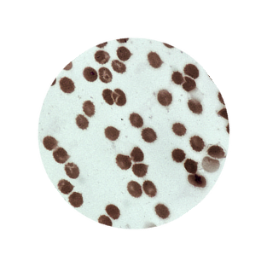
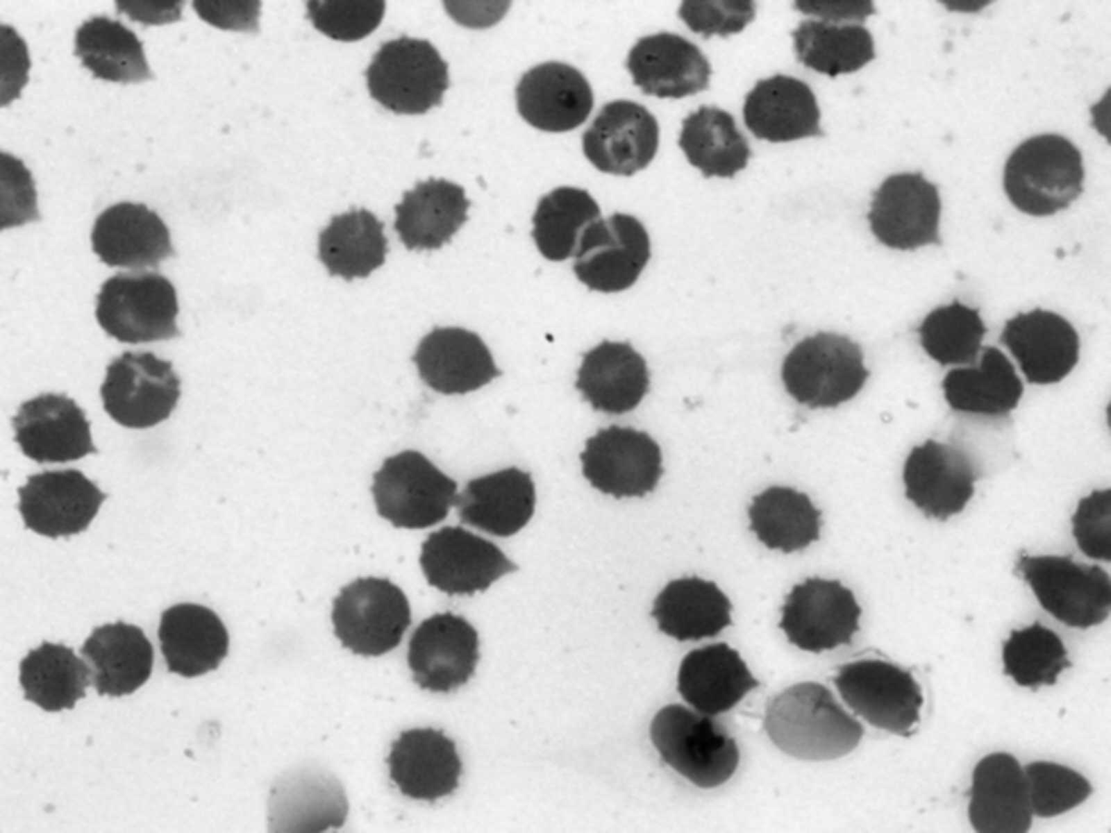
Data Preparation
Classification
Resized
Made circular
Rotated by up to 10 angles
Object Detection
Grayscale
GaussianBlur

Slide 11
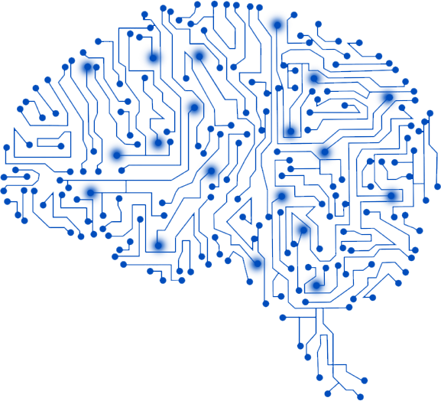
Models Used
Classification
9 layer convolutional neural network
Pre-trained ResNet-50
Object Detection
Faster RCNN

Slide 12
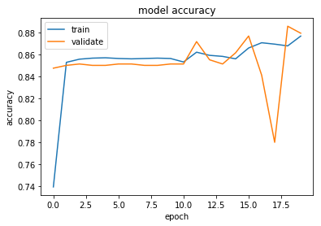
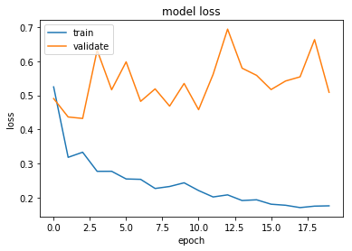
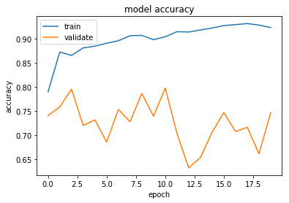
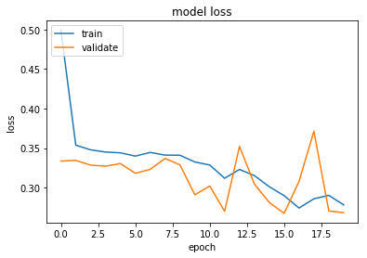
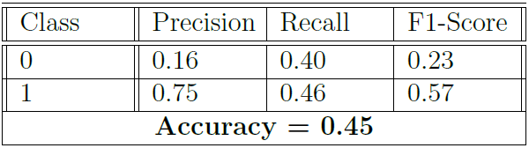
Evaluation and Results
Classification
CNN
ResNet-50

Slide 13
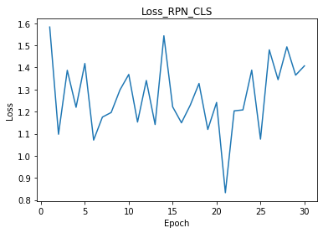
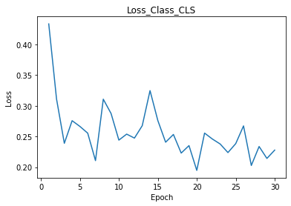
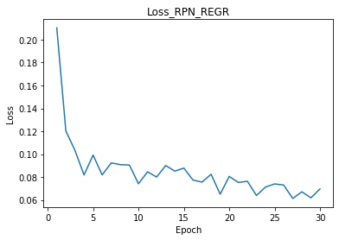
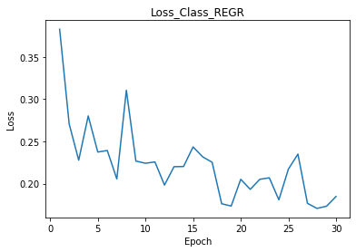
Evaluation and Results
Object Detection
Region Proposal Network(RPN)
Classification

Slide 14
Conclusion & Future work
Idea behind the project was to use convolutional neural networks for diagnosing malaria through classification of blood smear images into infected and healthy and to detect infected blood cells in the blood smear images.
This research project was a small step towards an era where diagnosis of malaria could be faster by using high end deep learning models integrated to an application and mobile phone.
Future scope could be to use much higher number of images so that the models could be trained on a variety of images. Currently, there are not a lot of publicly available images present on the internet.
Pre-processing of the images could be done in a different and more better way to achieve desirable results. Also, more number of images could be used in future for training.
Feature extraction could also be implemented in future.

Slide 15
Thank you!

